Slide 1
Introduction to 1 Thessalonians
Darryl Burling
http://da.rryl.me

Slide 2
Historical background
Initially named Therma
Renamed after Cassander’s wife
Capital of the second (of four) Roman divisions of Macedonia
Free city
Seat of Roman Governor
Remains to this day
Strategically located – Gateway to the west

Slide 3
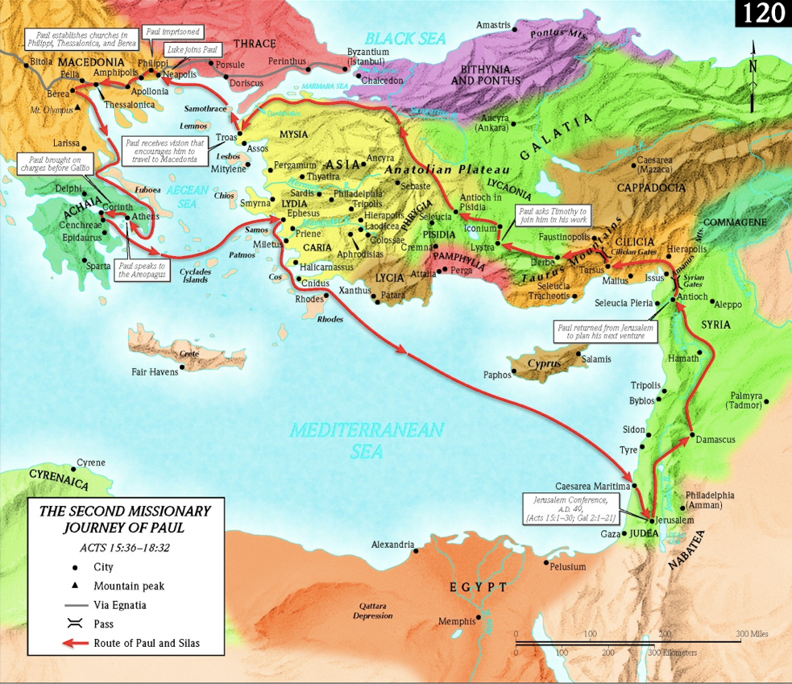

Slide 4
Paul comes to Thessalonica
Philippi
Beaten and imprisoned
Paul’s response
Thessalonica (Acts 17:1-10)
Length of stay (1:9, 2:8-9, 11-12, Phil 4:16)
What it cost Paul to evangelize (2:1-2, 9-12, 2 Th 3:8)
What it cost the Thessalonians (1:6-7, 2:13-14)

Slide 5
Application
What evidence does Paul give for their salvation?
What do we tend to minimize or over emphasize?
What are the differences between the church in Thessalonica and our church? What is the same?
What motivates you?
Who are you imitating?

